Slide 1
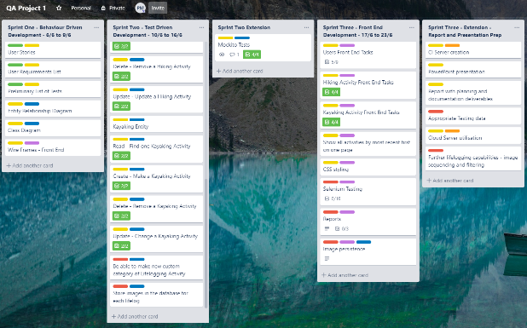
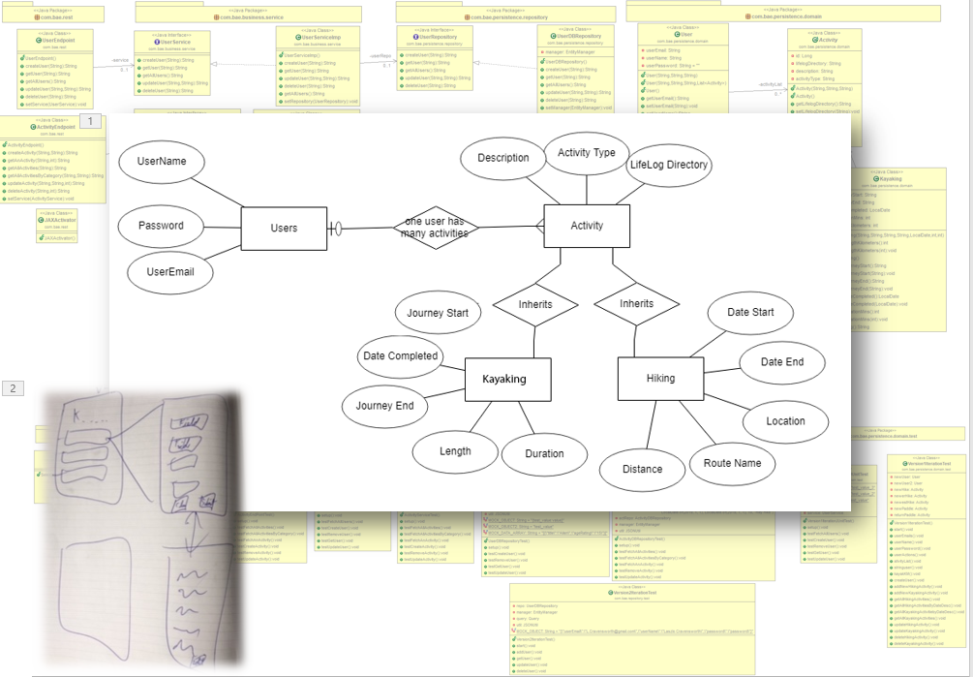
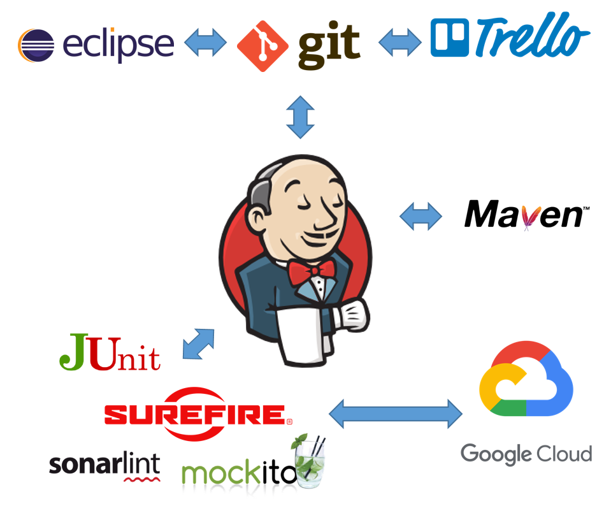
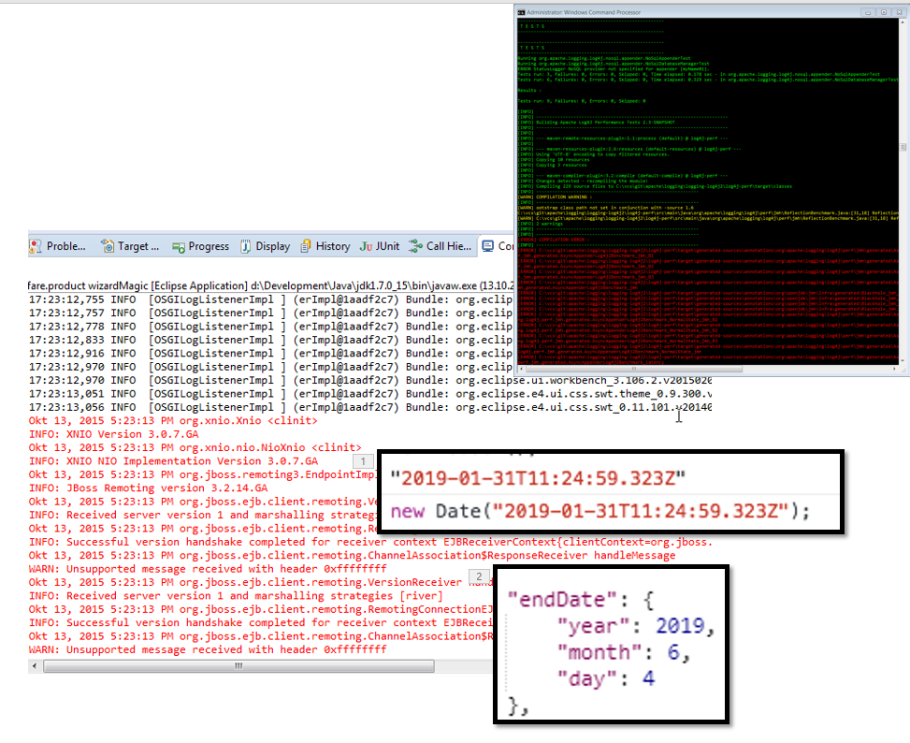
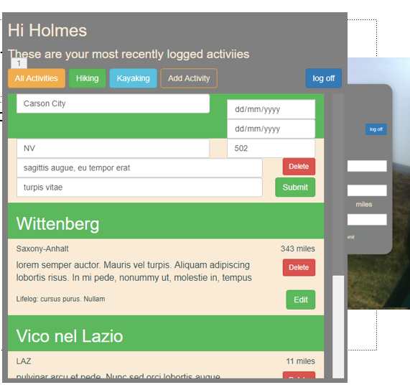
Agile
Diagrams
CI Software
TDD
Interface

Slide 2


Slide 3
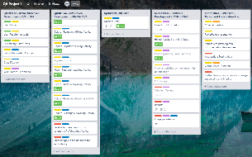
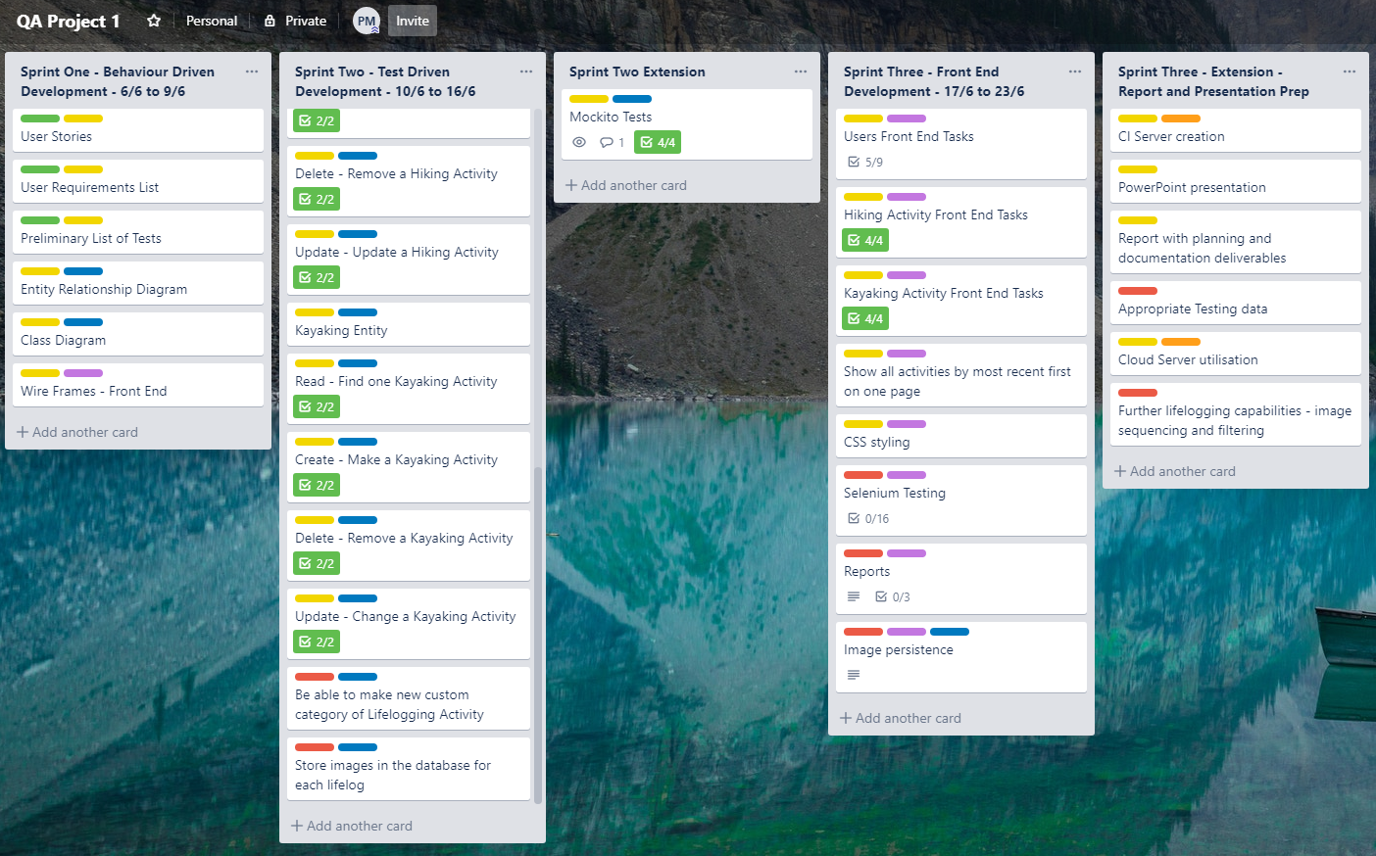
Agile
Agile Method
Diagrams
Diagrams
CI Software
CI Software
TDD
TDD
Interface
Interface

Slide 4
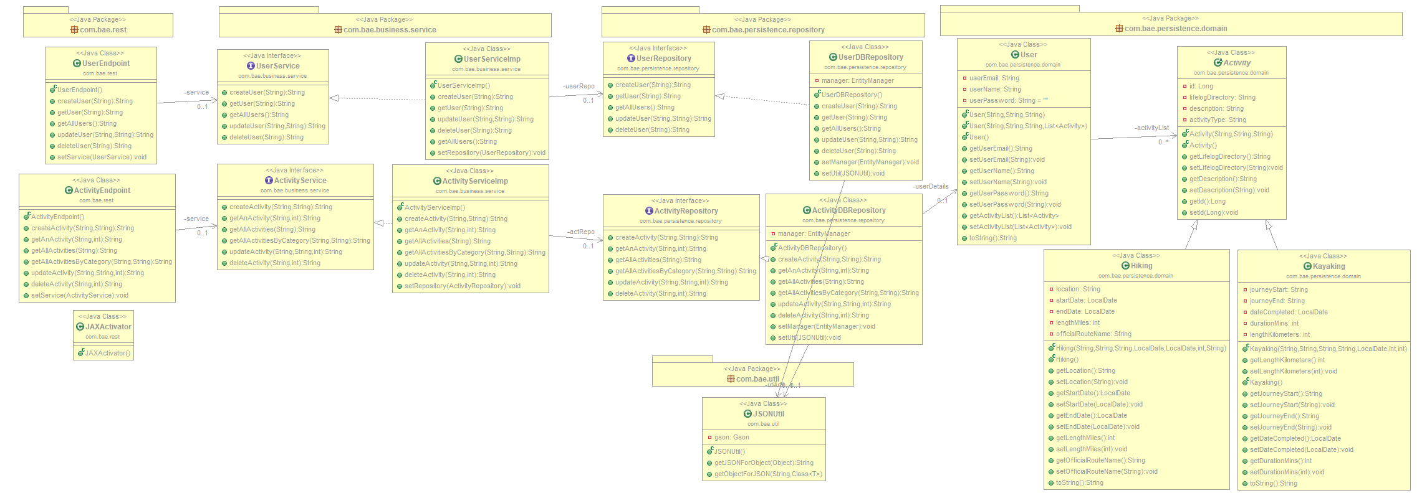
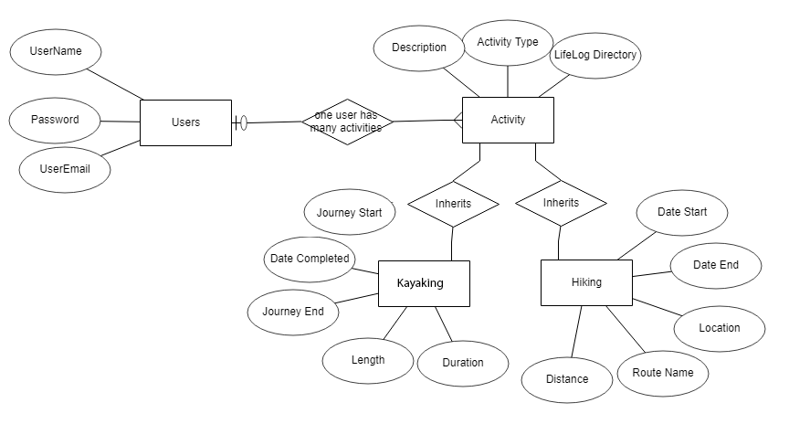
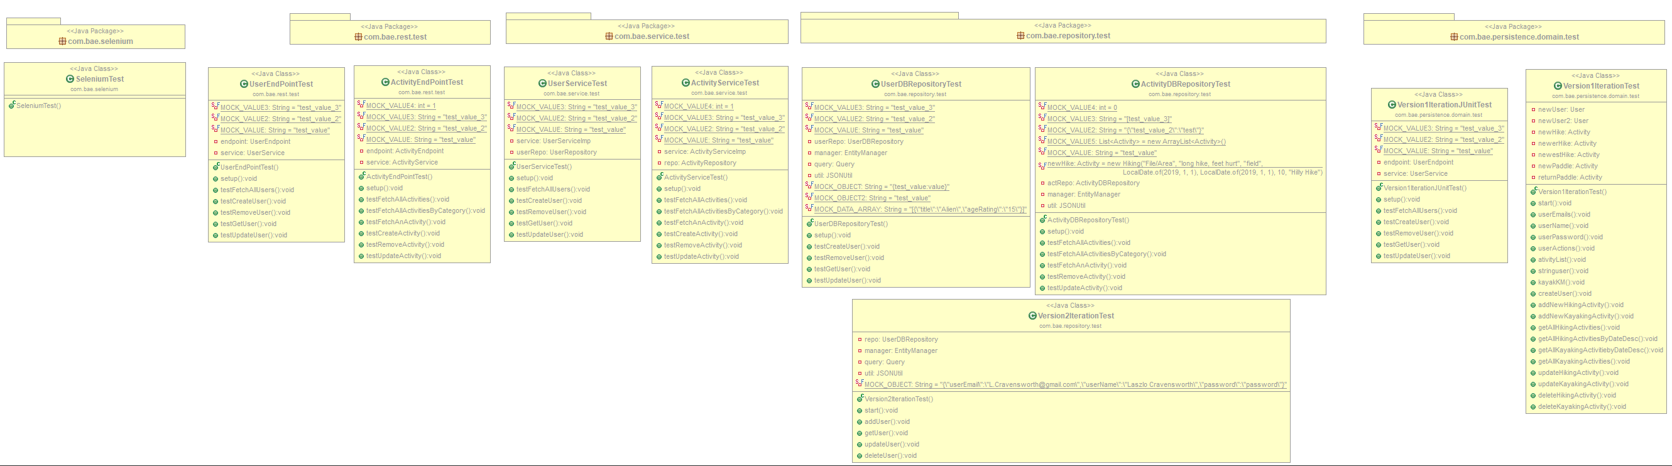
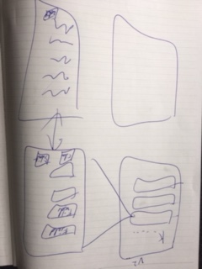
Diagrams
Agile
Diagrams
Diagrams
CI Software
TDD
Interface

Slide 5











Agile
CI Software
Diagrams
CI Software
CI Software
TDD
Interface

Slide 6
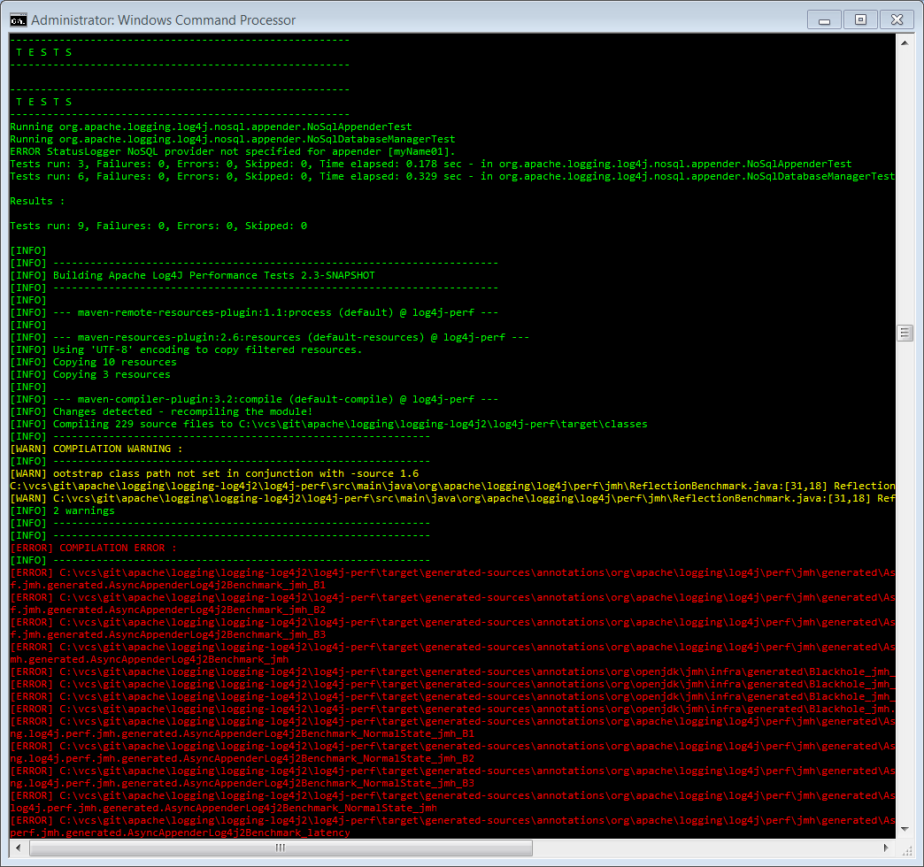
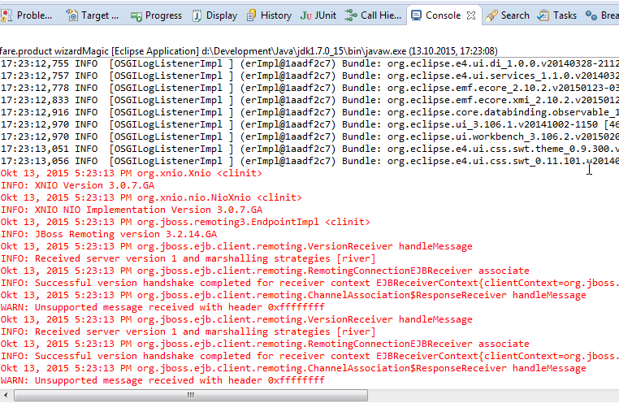
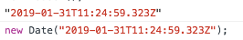
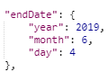
Agile
Test Driven Development - Bugs
Diagrams
CI Software
TDD
TDD
Interface

Slide 7
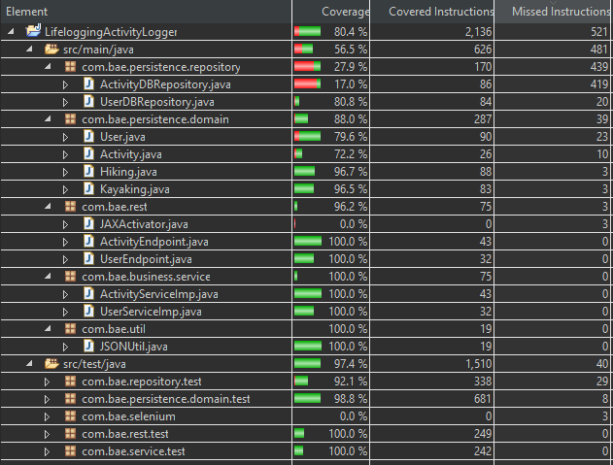
Agile
Test Driven Development – Coverage (Java only)
Diagrams
CI Software
TDD
TDD
Interface

Slide 8
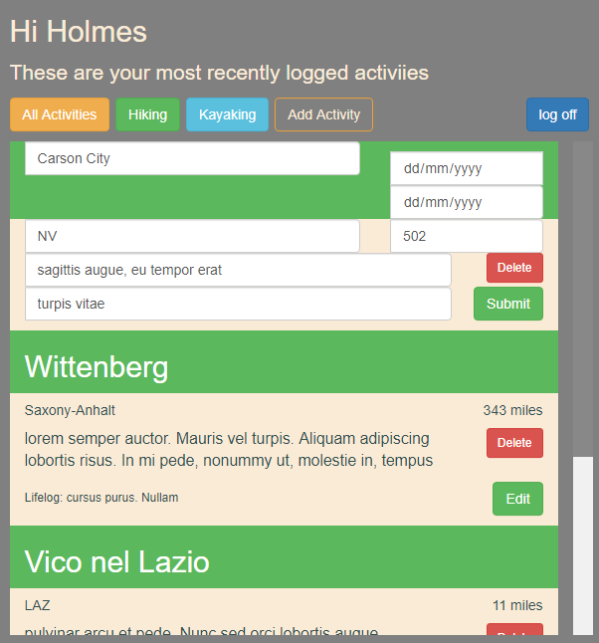
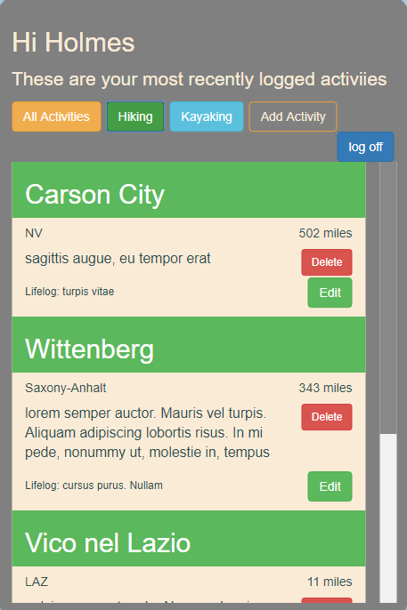
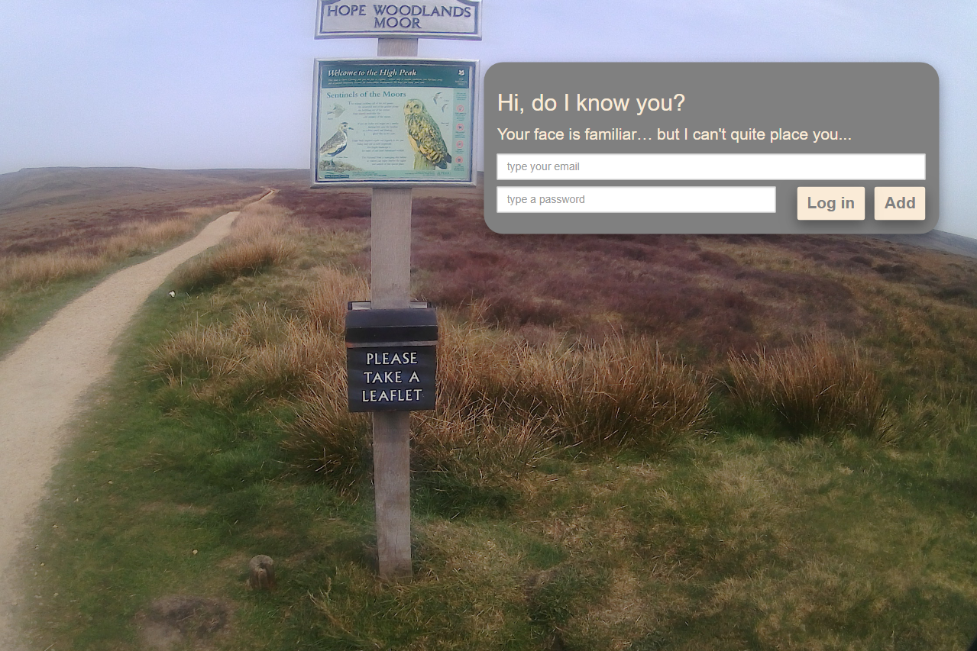
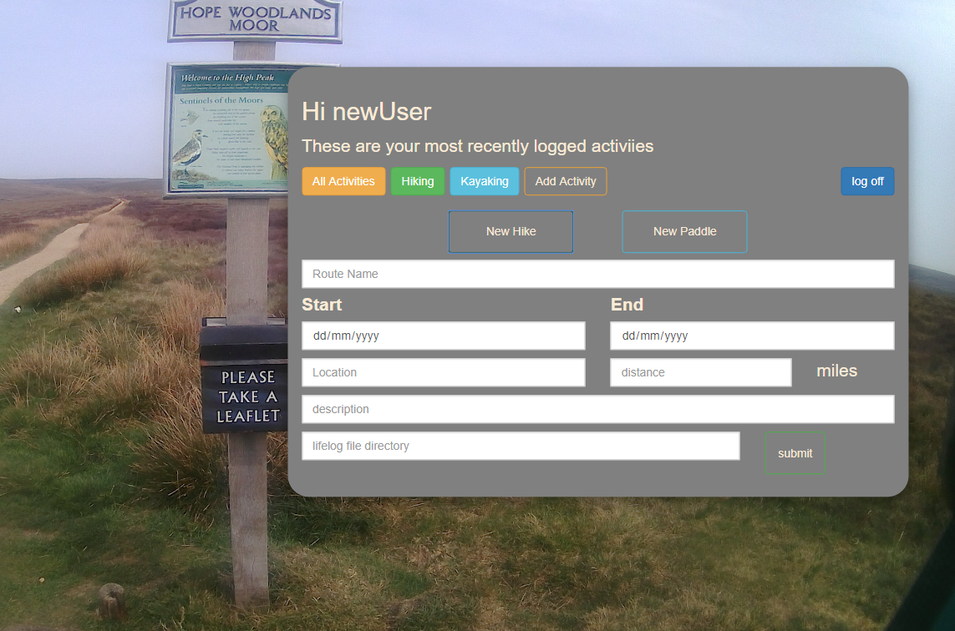
Agile
Interface
Diagrams
CI Software
TDD
Interface
Interface

